Slide 1
Sharing common assemblies between processes and domains
Article: https://habrahabr.ru/post/341950/
Source code: https://github.com/sflusov/IISSharingAssemblies

Slide 2
The presentation target
Show the optimization path for your applications
Show a few tools for analyzing optimization paths and their impact on your applications
Tools used in presentation.
Sysinternals Process Explorer v16.21
Sysinternals VMMap v3.21

Slide 3
Agenda
What do you really mean by memory? Memory structure and types.
Sharing assemblies between application domains. Concept domain neutral assembly.
Sharing assemblies between processes. Concept native images.
Real example based on Marketplace development server

Slide 4
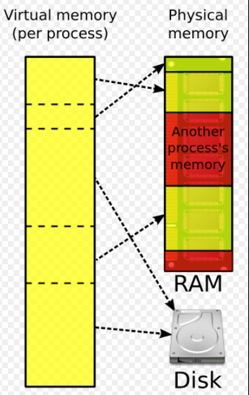
What do you really mean by memory?
Virtual and physical memory
Virtual memory:
32-bit - 2GB per process
64-bit – 128TB per process
See also:
http://blogs.microsoft.co.il/sasha/2016/01/05/windows-process-memory-usage-demystified/

Slide 5
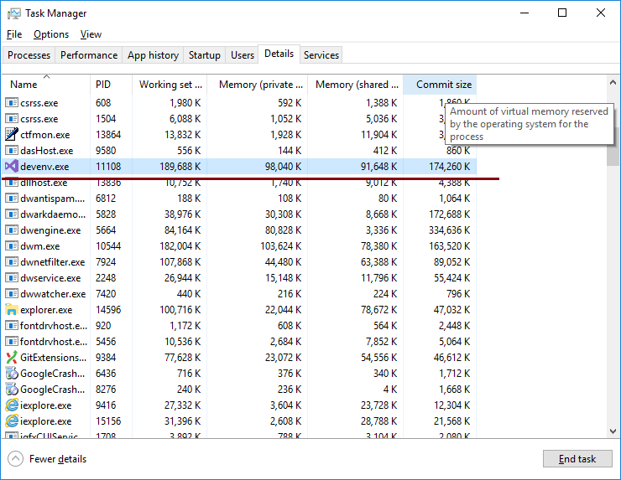
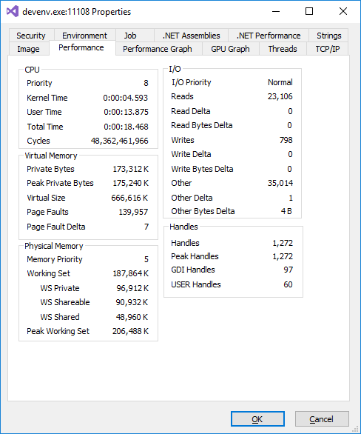
What do you really mean by memory?
Have a look on application through Task Manager and Process Explorer
Virtual memory:
Commit size
Physical memory:
Private working set
Shared working set
Working set = Private + Shared
Task manager
Process Explorer
Remarks: * There are some deviations in values, because screenshot was made at different time

Slide 6
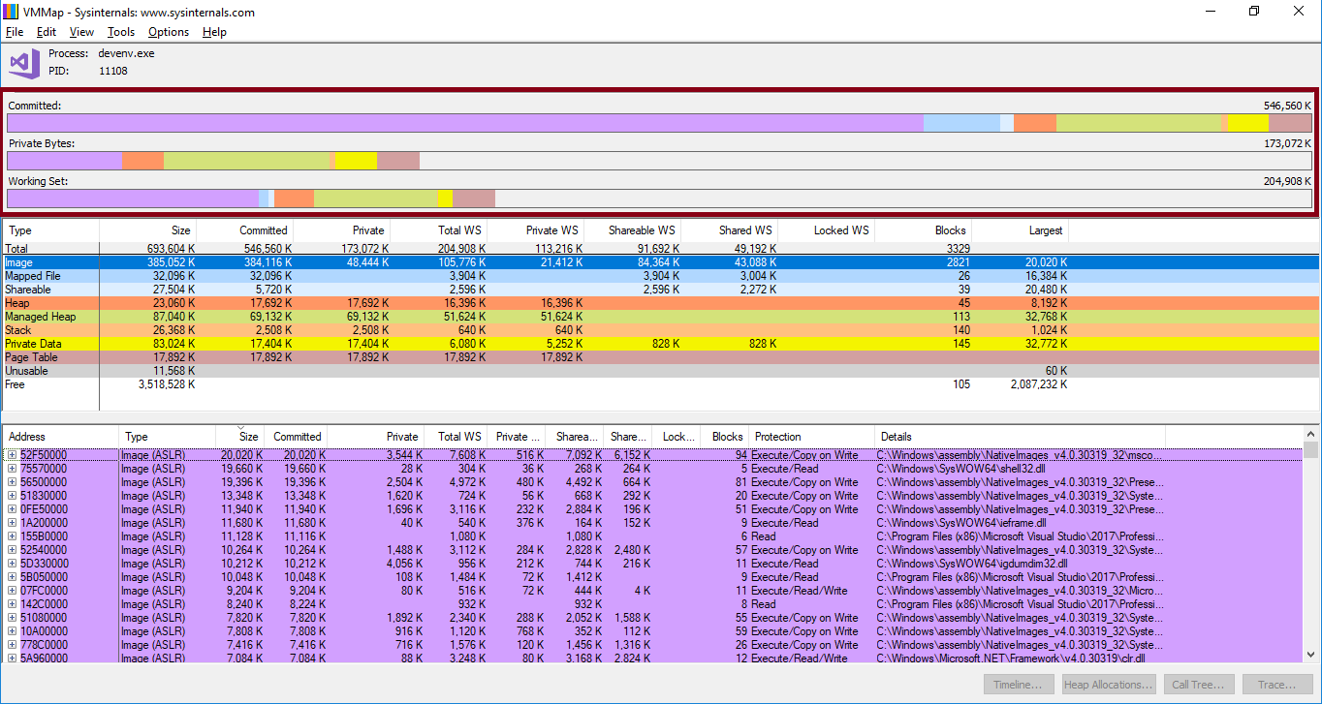
What do you really mean by memory? Memory types
Open VMMap and have a look of application structure
Bar graphs:
Committed – virtual memory, which allocated memory, but not used
Private Bytes - virtual memory, which already use
Working set - physical memory
See also:
http://blogs.microsoft.co.il/sasha/2016/01/05/windows-process-memory-usage-demystified/
Windows® Sysinternals Administrator’s Reference. Pages 216-218

Slide 7
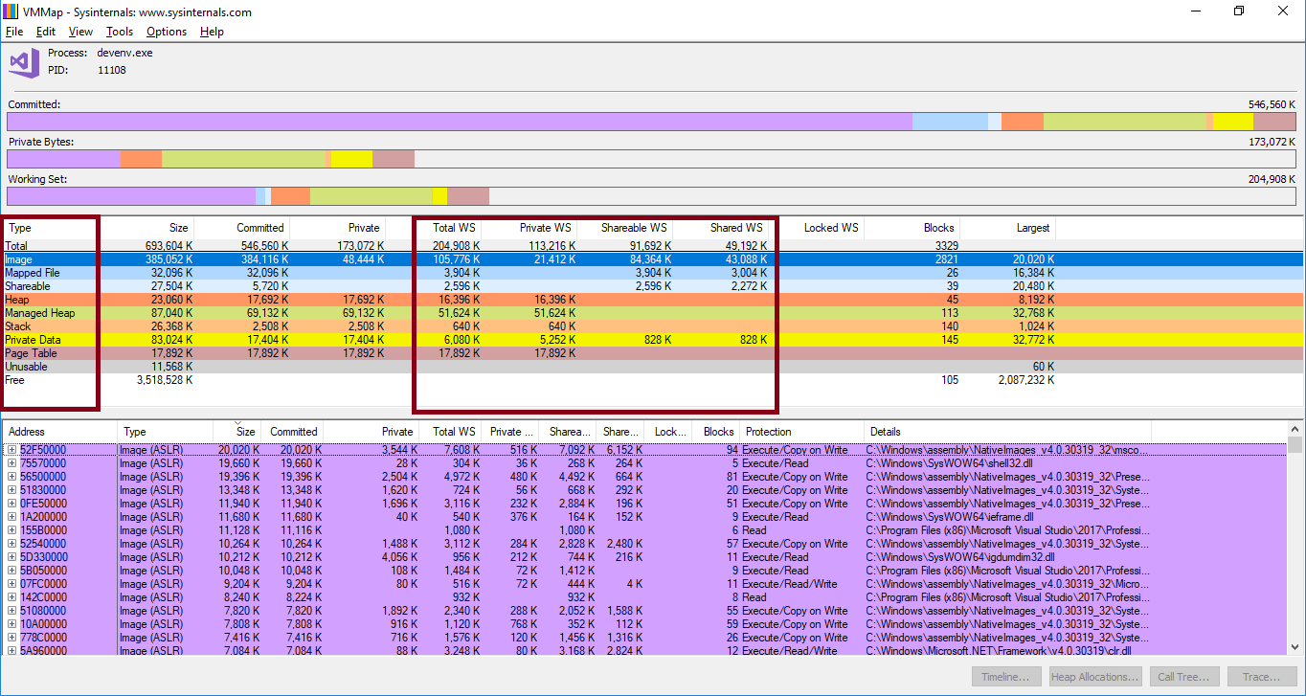
What do you really mean by memory? Memory types
Open VMMap and have a look of application structure
Columns:
Image – memory represents an executable files: EXE or DLL
Heap – memory allocated C/C++ runtime
Managed Heap - memory allocated .NET runtime **
See also:
http://blogs.microsoft.co.il/sasha/2016/01/05/windows-process-memory-usage-demystified/
Windows® Sysinternals Administrator’s Reference. Pages 216-218

Slide 8
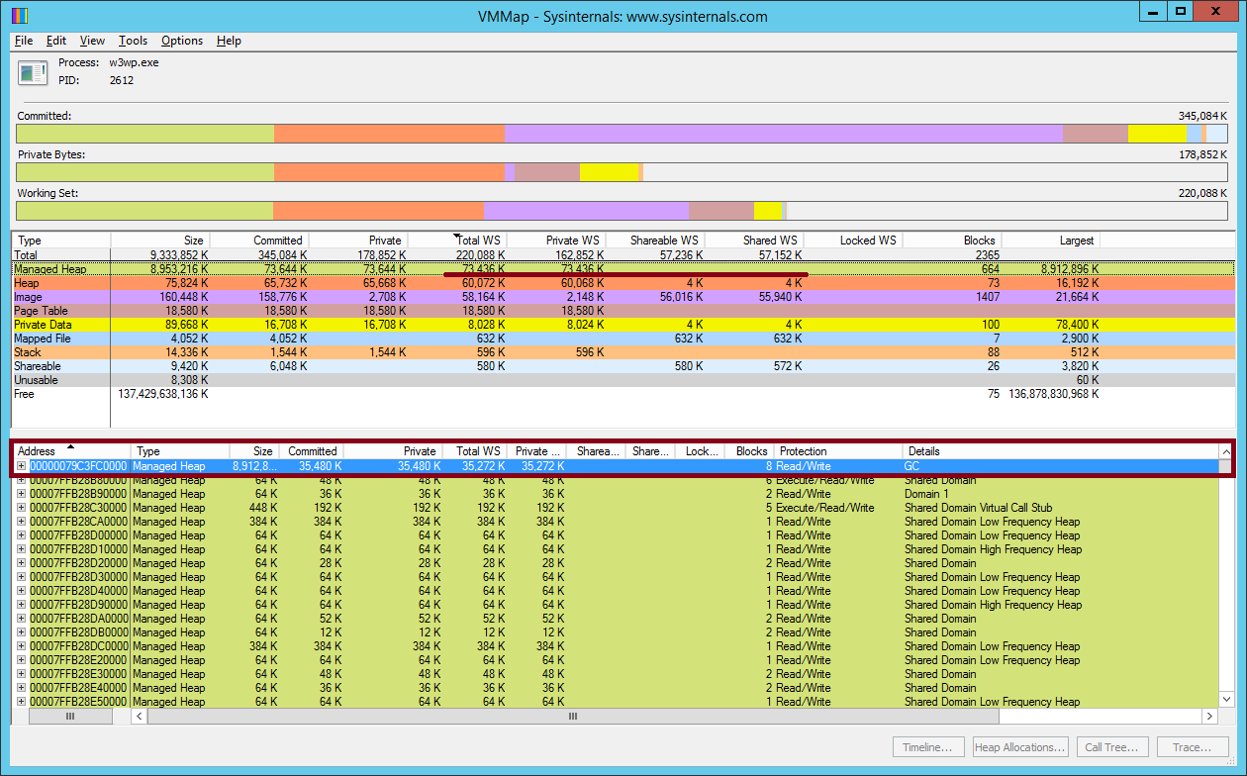
What do you really mean by memory? Memory types
Open VMMap and have a look of application structure
Remarks
JIT code included in Managed Heap, you can calculate them size as Managed Heap minus GC

Slide 9
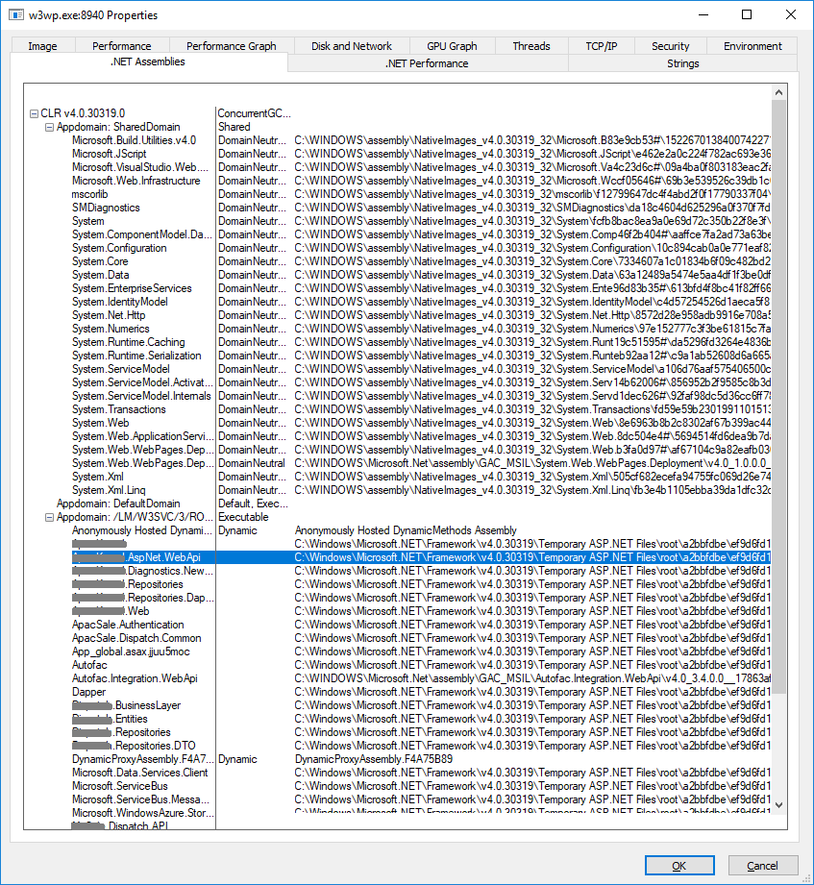
Sharing assemblies between application domains Concept domain neutral assembly
Open process explorer and find our application, after open tab .NET assemblies
Domain neutral assembly
Conceptually, a domain neutral assembly is an assembly that lives across multiple appdomains.
Domain neutral assemblies will be jitted only once.
The jitted code, as well as various runtime data structures like MethodTables, MethodDescs, will be shared across appdomains.
See also:
https://blogs.msdn.microsoft.com/junfeng/2004/08/05/domain-neutral-assemblies/
Process Explorer
Notes:
Have a look simulation
Have a look real example on MP server

Slide 10
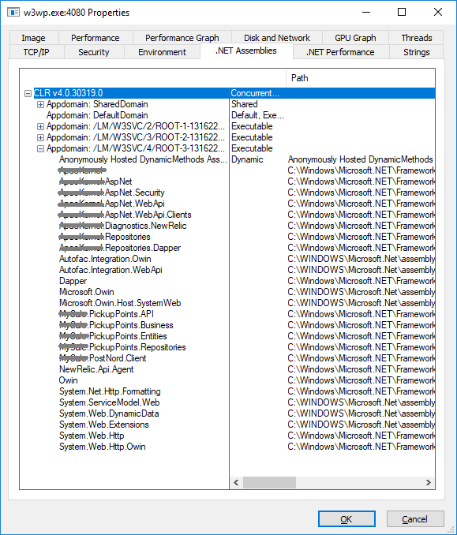
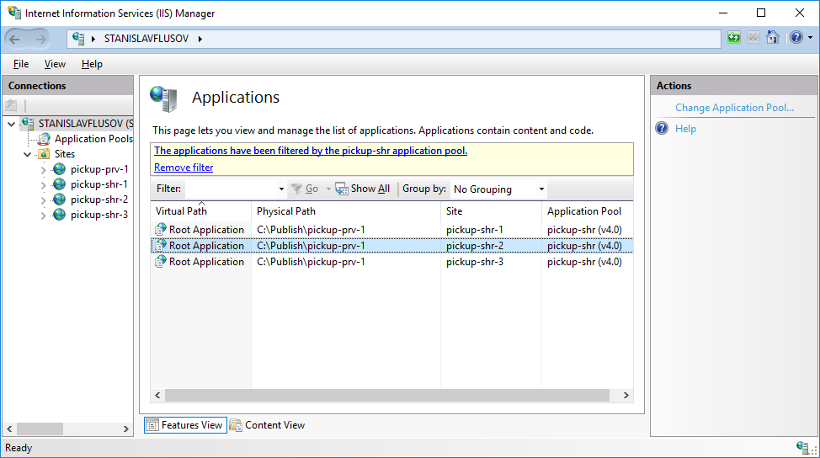
Sharing assemblies between application domains Concept domain neutral assembly
Let's combine 3 instance of the same API to one app pools
Process Explorer
Notes:
Have a look simulation
Have a look real example on MP server

Slide 11
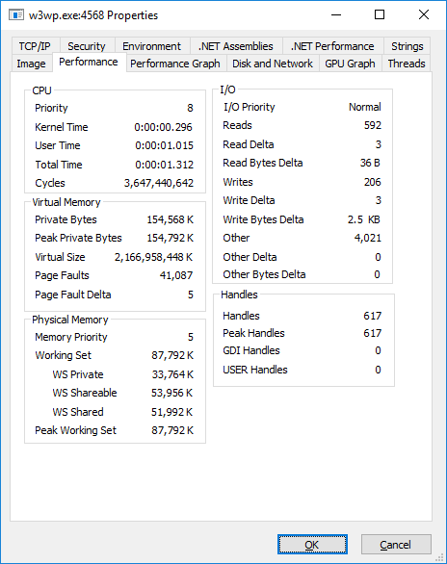

Sharing assemblies between application domains Concept domain neutral assembly
Let's combine 3 instance of the same API to one app pools and compare memory usage
One site in appPool
Three sites in appPool
Notes:
Have a look simulation
Have a look real example on MP server

Slide 12
Sharing assemblies between application domains Concept domain neutral assembly
Conclusion from a previous slide:
An assembly can be domain neutral if and only if it is in GAC, and all the assemblies in its transitive binding closure are all in GAC.

Slide 13
Sharing assemblies between processes Concept native images
Ngen.exe (Native Image Generator)
Summary of usage
Native images enable code sharing between processes
Native images require a smaller initial working set because there is no need for the JIT compiler
Native images load faster than MSIL because they eliminate the need for many startup activities, such as JIT compilation and type-safety verification
See also:
https://docs.microsoft.com/en-us/dotnet/framework/tools/ngen-exe-native-image-generator

Slide 14
Sharing assemblies between processes. Concept native images.
Remarks:
Always use domain-neutral code when loading the same assembly into multiple application domains. If a native image is loaded into a nonshared application domain after having been loaded into a shared domain, it cannot be used.

Slide 15
Summary
Step | Warming time | Total memory usage | Average memory usage per service
Initial conditions ** | 6 min 43 sec | 8 GB | 7 GB / 47 = 152 Mb
1. App pools combining 2. load lib to GAC ** | 2 min 33 sec | 4.1 GB | 3.1 GB / 47 = 67 Mb
1. App pools combining 2. load lib to GAC 3. make native images | 2 min 12 sec | 2.2 GB | 1.2 GB / 47 = 26 Mb
Remarks:
* There are some deviations in values, because screenshot was made at different time
** NewRelic agent installed

Slide 16
Thank you
References
https://www.microsoftpressstore.com/store/windows-internals-part-1-9780735648739
https://www.microsoftpressstore.com/store/windows-sysinternals-administrators-reference-9780735656727
http://www.apress.com/us/book/9781430244585
Article: https://habrahabr.ru/post/341950/
Source code: https://github.com/sflusov/IISSharingAssemblies

